Slide 1

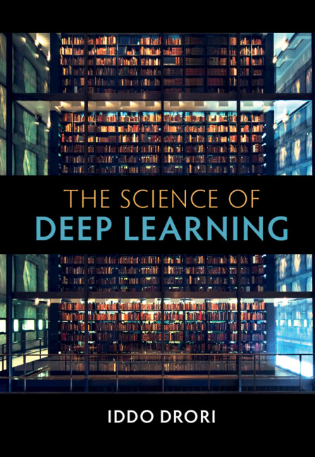
[Core Text]: [COURSE NUMBER]: [COURSE NAME]
Insert book cover
The Science of Deep Learning
1st Edition
By Iddo Drori, Massachusetts Institute of Technology and Columbia University, New York
Available from [College Bookstore] or www.cambridge.org/highereducation/isbn/9781108835084

Slide 2

Part I - Foundations
1 – Introduction; 2 - Forward and Backpropagation
3 – Optimization; 4 - Regularization
Part II - Architectures
5 - Convolutional Neural Networks; 6 - Sequence Models; 7 - Graph Neural Networks; 8 - Transformers
Part III - Generative Models
9 - Generative Adversarial Networks; 10 - Variational Autoencoders
Part IV - Reinforcement Learning
11 - Reinforcement Learning; 12 - Deep Reinforcement Learning
Part V - Applications
13 - Applications
Matrix Calculus
Scientific Writing and Reviewing Best Practices
References
Index
The Science of Deep Learning emerged from courses taught by the author that have provided thousands of students with training and experience for their academic studies, and prepared them for careers in deep learning, machine learning, and artificial intelligence in industry and academia.
The book begins by covering the foundations of deep learning, followed by key deep learning architectures, and includes state-of-the-art topics such as Transformers, graph neural networks, variational autoencoders, and deep reinforcement learning, with a broad range of applications.
What is covered by the text?

Slide 3
Features
Clear visualizations using a unified notation make the material accessible to students, teachers, and researchers, in academia and industry of diverse backgrounds
Key topics are introduced using basic linear algebra and graphs simultaneously, along with the corresponding algorithms
Chapters on transformers, GNNs, variational inference and deep reinforcement learning present state-of-the-art techniques and applications
Contains around 200 figures, 500 equations, and 25 algorithms, all using the same graphical, mathematical, and pseudocode notation
Accompanying web site provides code samples synthesized automatically for each topic at various levels, allowing students to connect concepts in text with code implementations
Hundreds of online exercises automatically generated with their corresponding solutions, letting students use fresh content for practice

Slide 4
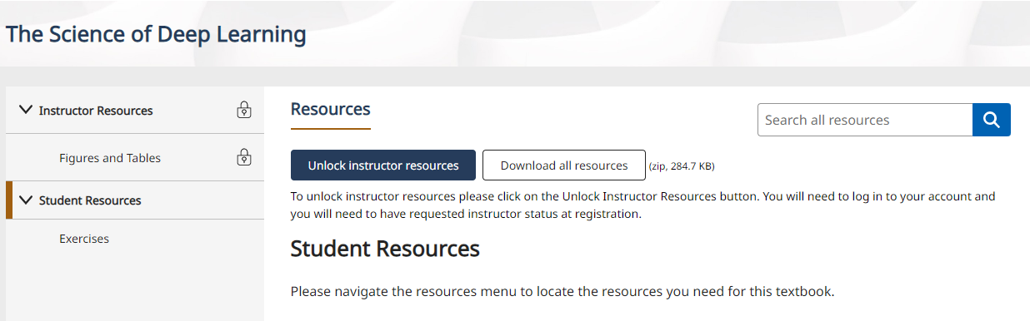
Supplementary Materials for Students
Exercises
https://www.cambridge.org/highereducation/books/the-science-of-deep-learning/23B3CE5B09590BD9E30474C850FA5358/resources/student-resources/41031AEA59090827210CEE5B3B2D7121/exercises/1F45FCC5DAE2A072D2494149A71FC401
Students do not need and should not need to request access to free instructor resources.

Slide 5
What is the Cambridge Spiral eReader?
The eReader app allows students to download the textbooks that they can access via their institution to their own offline reading bookshelf.
The eReader app allows students to highlight, bookmark and make notes within the online version of the textbook.
Students with institutional access will be able to read the book via their institutional login, but will need a Cambridge Higher Education account to access the full functionality
Our eTextbooks are also available for purchase by individuals who would like perpetual access

Slide 6
Accessing the Textbook Online
You will be able to access the textbook online via your institutional login or personal account.
In order to access the full functionality of Cambridge Spiral eReader, you will also need to create a Cambridge University Press Higher Education account.
To access the textbook for offline reading, please download the Cambridge Spiral eReader app.
For more access FAQs, please read here
When signing up for a HE account, you will not be automatically opted into any marketing or sales from Cambridge University Press, unless you change your preferences. Our privacy notice can be found here: www.cambridge.org/about-us/legal-notices/privacy-notice

Slide 7
What Systems does the app work on?
Download Cambridge Spiral for Higher Education from Cambridge University Press Offline Windows App
System Requirements: Windows 7+
Click here to download
Download Cambridge Spiral for Higher Education from Cambridge University Press Offline Desktop App (Apple Mac)
System Requirements: Mac OS 10.12 Sierra and above.
Click here to download
Download Cambridge Spiral for Higher Education from Cambridge University Press iOS App (iPhone/iPad)
System Requirements: iOS 10.0 and above. Download the app from the Apple Store
Cambridge Spiral for Higher Education from Cambridge University Press Android App
System Requirements: Android version 8.0 and above. Download the app from Google Play

